Slide 1
Best Cluster of Neighborhoods from Queens and Manhattan Boroughs Offering Multi-cultural Food Restaurants.
Pravinkumar Kandhare, PhD Student.
University of Alabama, Birmingham

Slide 2
Contents:
Problem Statement, Audience and Dataset
Visualization of neighborhoods on map
Manhattan and Queens restaurant venue dataset from Foursquare API
K-means clustering algorithm
Analyze clusters of Manhattan and Queens
Best cluster offering a greater number of multi-cultural restaurants
Conclusion

Slide 3
1. Problem Statement , Audience and Dataset:
Problem Statement:
“Compare the boroughs (Manhattan and Queens) of the New York city and determine the best cluster that offers large number of multi-cultural food restaurants.”
Clustering neighborhood of each borough will be done by choosing top three most common venue restaurants categories. Then, analyzing all clusters we would like to ask following questions.
Which borough cluster has largest variety of multi-cultural restaurants.
Discussion on cluster distribution on each borough
Who is Audience:
Multicultural Food Lovers
Datasets:
New York city dataset: contain boroughs and their neighborhood along with latitude and longitude features. (“https://cocl.us/new_york_dataset”)
Foursquare venue dataset: contains venue, neighborhood and other venue related information.(“https://api.foursquare.com”)

Slide 4
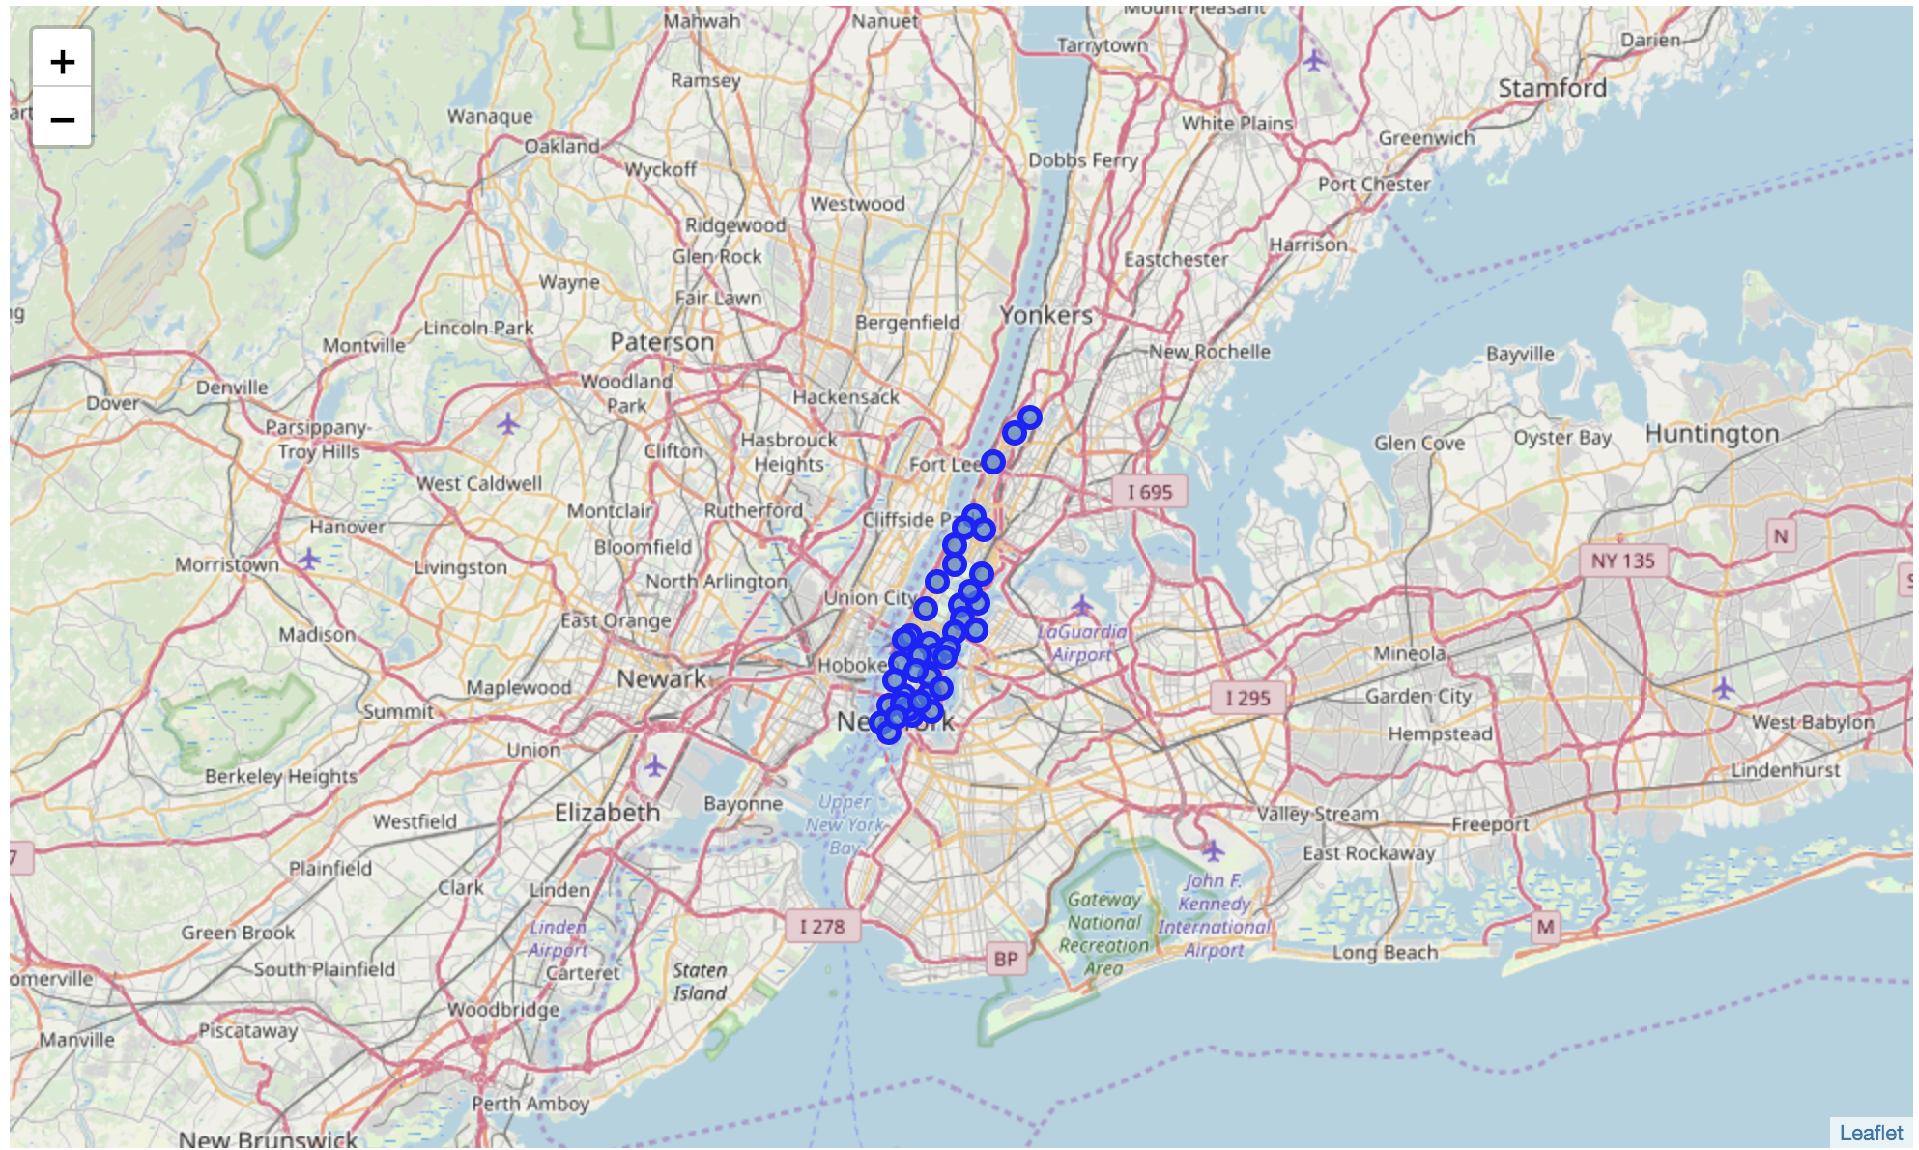
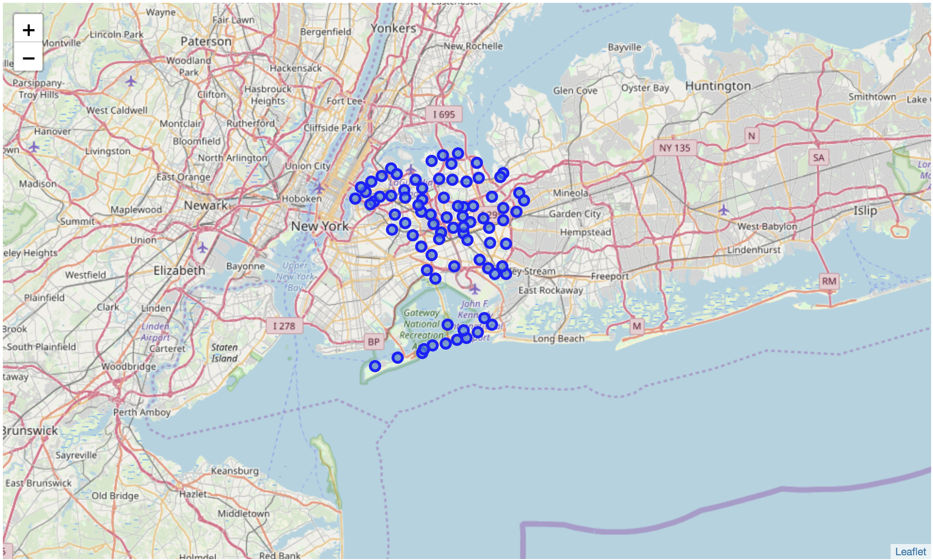
2. Visualization of neighborhoods on Maps:
Manhattan Neighborhoods on Map Queens Neighborhoods on Map
Total Number of Manhattan’s Neighborhoods : 39 Total Number Queen’s Neighborhoods: 70
New York dataset processed for getting two different dataset (Manhattan and Queens)
Neighborhood of each borough is displayed on Map
Queen has more number of neighborhoods compared to Manhattan

Slide 5
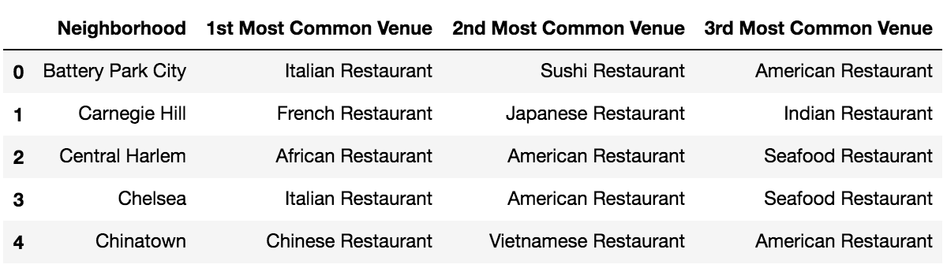
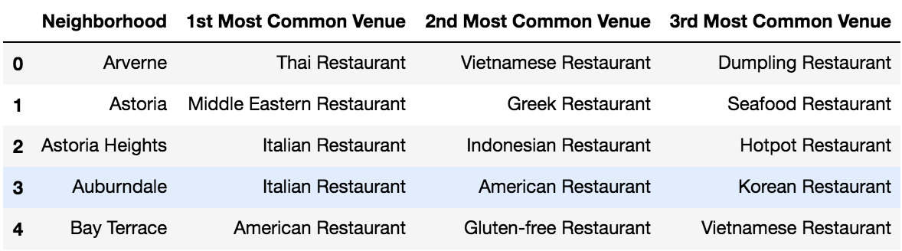
3. Manhattan and Queens restaurant venue datasets from Foursquare API:
Our interest is in only top 3 most common venue restaurants of each neighborhood among the Manhattan and Queens borough’s dataset.
Filtered sample restaurant datasets for Manhattan and Queens are as follows.
Manhattan Total Neighborhoods : 39 Queens Total Neighborhoods: 70
Top 3 most common restaurant venues in each neighborhood of Manhattan and Queens
Note*: Only first five values of datasets are displayed
Let’s analyze top 3 most common venue restaurants of Manhattan and Queens and check their popular (highest count) restaurant category.
1st Most Common Restaurant Venue Category of Manhattan and Queens
2nd Most Common Restaurant Venue Category of Manhattan and Queens
3rd Most Common Restaurant Venue Category of Manhattan and Queens

Slide 6
3.1 1st Most Common Restaurant Venue Category of Manhattan and Queens:
Manhattan Total Neighborhoods : 39 Queens Total Neighborhoods: 70
Queen has a greater number of “1st most common venue restaurant” categories compared to Manhattan
Italian Restaurant is a “1st most common venue restaurant” categories for Manhattan and Queens boroughs

Slide 7
3.2 2nd Most Common Restaurant Venue Category of Manhattan and Queens:
Manhattan Total Neighborhoods : 39 Queens Total Neighborhoods: 70
Queen has a greater number of “2nd most common venue restaurant” categories compared to Manhattan
Sushi Restaurant and Chinese Restaurant are “2nd most common venue restaurant” categories for Manhattan and Queens respectively.

Slide 8
3.3. 3rd Most Common Restaurant Venue Category of Manhattan and Queens:
Manhattan Total Neighborhoods : 39 Queens Total Neighborhoods: 70
Queen has a greater number of “3rd most common venue restaurant” categories compared to Manhattan
American Restaurant & Vietnamese Restaurant are “3rd most common venue restaurant” categories for Manhattan and Queens respectively.

Slide 9
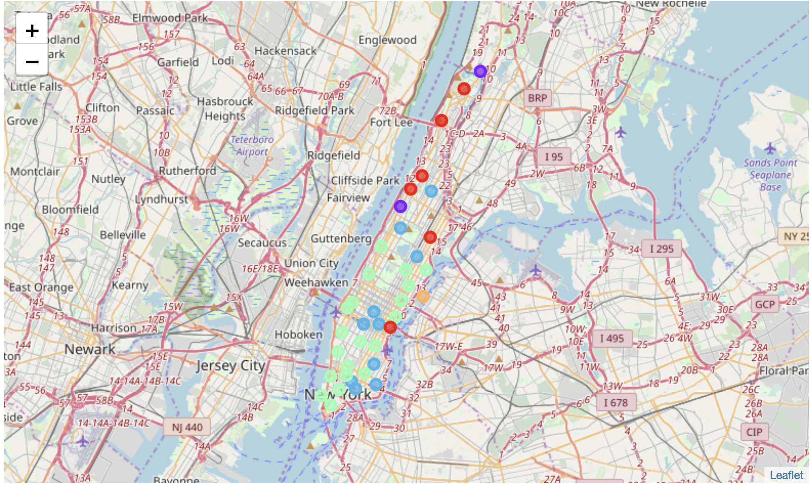
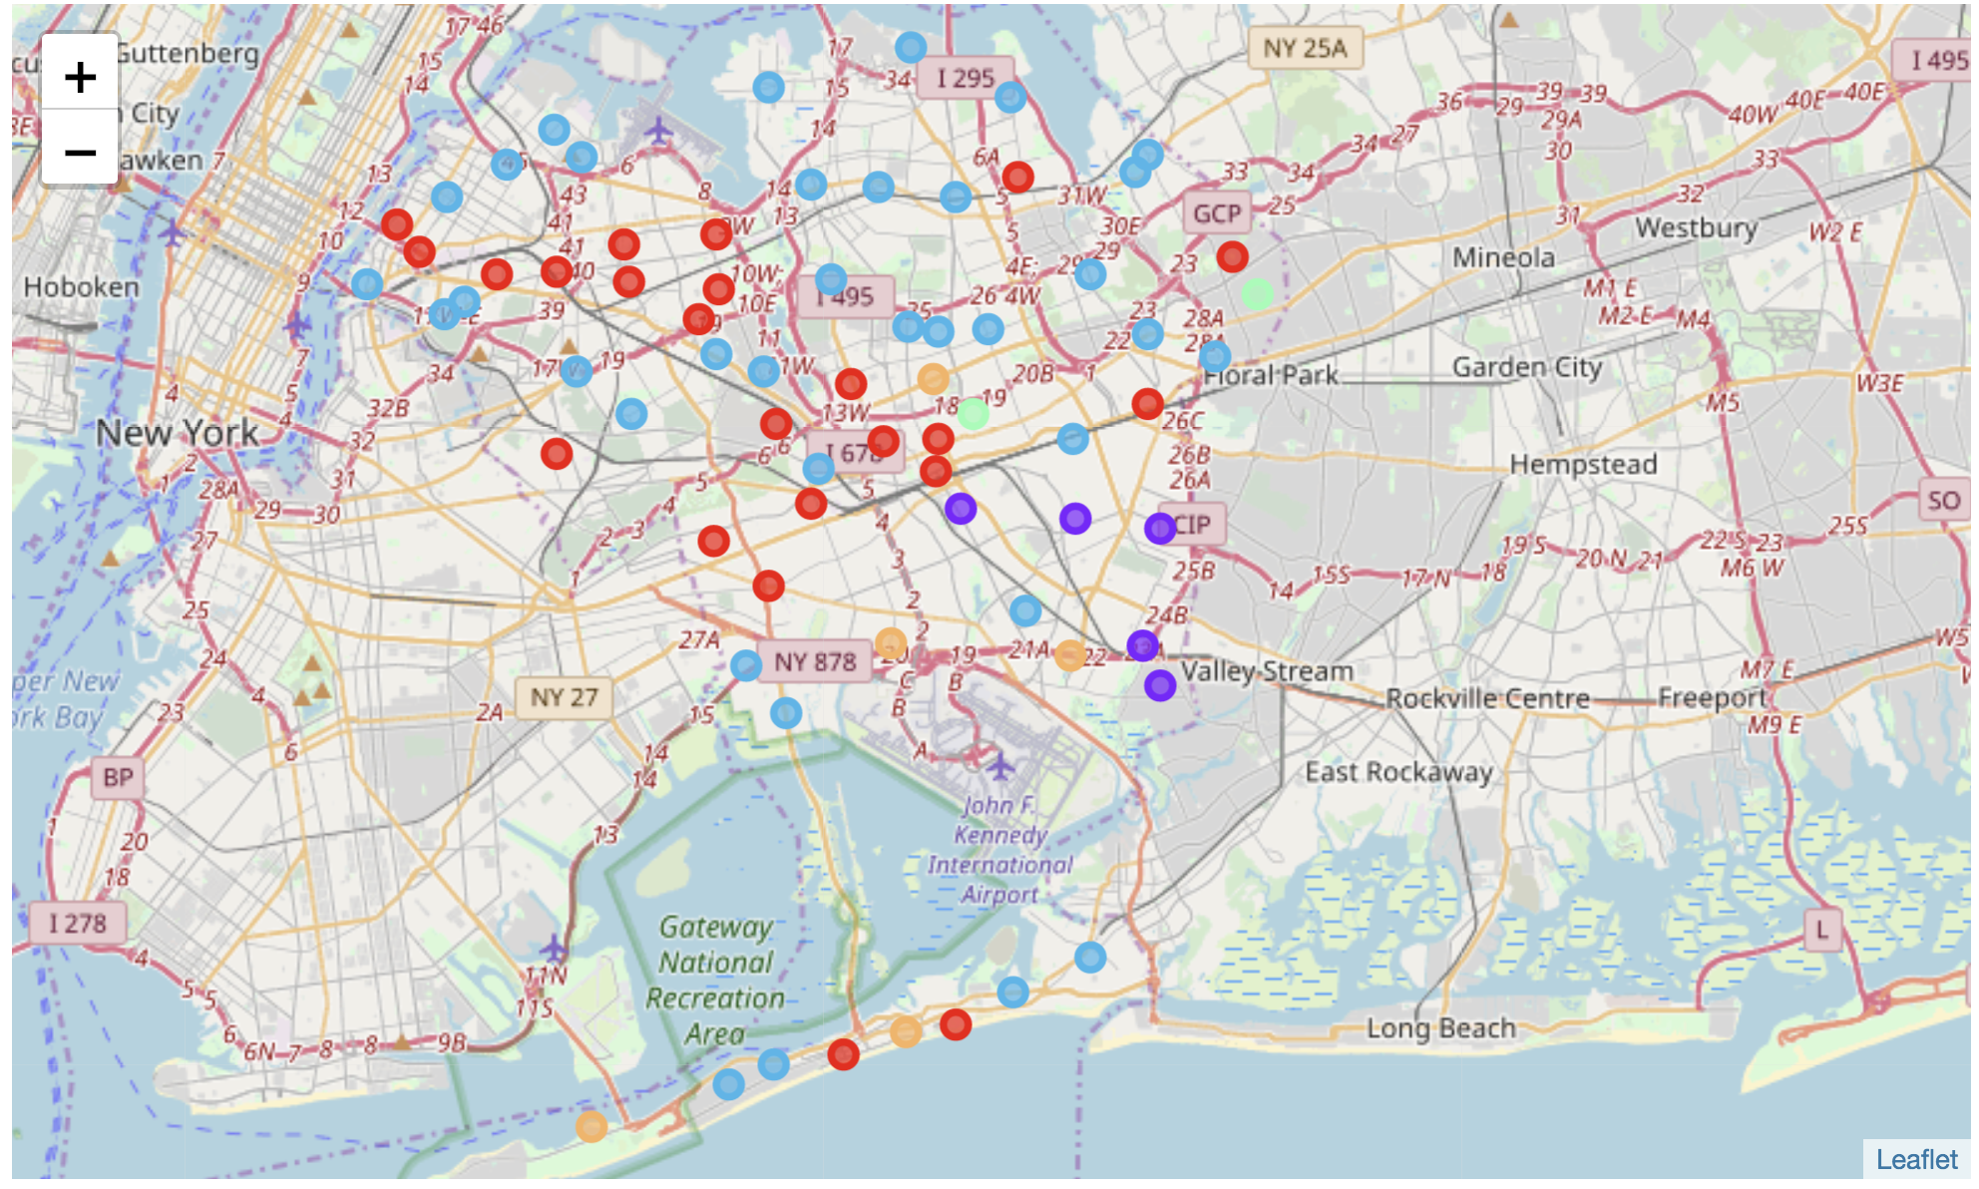
4. K-means clustering algorithm:
Applied K-mean clustering algorithm using cluster value K=5.
Clustering results of Manhattan and Queens “top 3 most common venue restaurant” datasets.
Manhattan Neighborhoods clustering Map Queens Neighborhoods clustering Map
Manhattan Total Neighborhood : 39 Queens Total Neighborhood: 70
Observations:
In Manhattan’s map, ” light green” colored cluster contains greater number of neighborhoods compared to other clusters.
In Queens map, ”light blue ” colored cluster contains greater number of neighborhoods compared to other clusters
Let’s check assigned label counts for each cluster.

Slide 10
5. Analyze clusters of Manhattan and Queens:
Distribution of assigned clustered labels of Manhattan and Queens neighborhoods dataset .
Manhattan Clusters Labels Queens Clusters Labels
Manhattan Total Neighborhood : 39 Queens Total Neighborhood: 70
Observations:
Manhattan cluster number 3 contains greater number of neighborhoods compared to others
Queens cluster number 2 contains greater number of neighborhoods compared to others
Guessing solution of our problem:
Cluster number 2 of Queens has largest number of neighborhoods among all clusters.
Guess can be made that cluster 2 may offer more number of multi-cultural food restaurants. Again, It just a guess. Let’s see the correct results !!!

Slide 11
5.1 Analyze Manhattan’s all five clusters along with their restaurant category:
Select cluster that has maximum number of restaurant categories for top 3 most common venues: To make decision simple, we will choose right now these two highlighted clusters among Manhattan’s five clusters.

Slide 12
5.2 Analyze Queens all five clusters along with their restaurant category:
Select the cluster that has maximum number of restaurant categories for 3 most common venues: To make decision simple, we will choose again these two highlighted clusters among Queens five clusters.

Slide 13
6. Best cluster offering a greater number of multi-cultural food restaurants:
From previously selected four clusters, it can be concluded that “Queens cluster2 ” offers wide variety of restaurant categories and number of restaurants compared to all other clusters.
This clustering information will help multicultural food lovers in making decision about the food locations and having all kinds of different ethnic food at one place or within shorter distances.

Slide 14
7. Conclusion:
“Queens cluster2 ” offers wide variety of ethnic restaurant categories and number of restaurants.
Odd distribution of clusters observed for Queens and Manhattan boroughs.
Difference between Queens and Manhattan total number of neighborhoods is 31.
May produce biased clustering results because of unbalanced neighborhoods.

